Slide 1
Best Frac Crew Proposal
Sonya Pieklik, Marco Di Leo, Louie Wang, Kelly Chiu, Chris Lawson

Slide 2
Introduction/Technical Challenge
Finding the Best Frac Crew
Using given features determine a “best” frac crew
Qualitative: Time logs - descriptions, unstructured text blocks
Quantitative: Engineering variables (Proppant, stage length, etc)
“Best” is unknown
Open to interpretation, makes it difficult to start
Allows us spot relationships that aren’t initially apparent

Slide 3
Importance
Texas is an important base for hydraulic fracturing industry.
North America market dominates the total industry markets.
Finding the best resources can improve competency and facilitate market expansion.
Important for ConocoPhillips as the regulations related to fracking are increasing due to increased concerns of its environmental impacts.
Notes:
What should be here: why this is an important project and list how the results could help the company along with explaining why trying the best resources is important to development.
Original paragraphs
Texas is an important base within the industry being the home for many top fracturing companies and a hub for mass natural resources for the industry. Finding the best resource can, thus, facilitate the growth of the company and optimize the use of resources.
Hydraulic fracturing has a rapidly growing market and from our market analysis, North America has a dominating market (85% of the total revenue). Therefore, finding the best resource will be very helpful for the company to increase their competency within the market and help to expand its own market size.

Slide 4
Business Impact
The Market
Total Market Size ($): $28.13bn globally in 2019 ¹
Served Addressable Market ($): U.S. Market; $21.86bn in 2019 ¹
The Business
Hydraulic fracturing is a big source of unconventional gas energy
Finding the best frac crew can enhance production of oil and gas
Market Growth
Current Market Dip: 2019: $21.86 Billion, 2020: ~$16 Billion ¹
Market Projections: 2027: $37.51 Billion, CAGR of 8.8% ¹
https://www.fortunebusinessinsights.com/industry-reports/hydraulic-fracturing-market-100419
Notes:
What should be here (for Marco):
Explain how our project could have a business impact. Try to incorporate the data we provided in the Market Impact slide from our last slide set

Slide 5
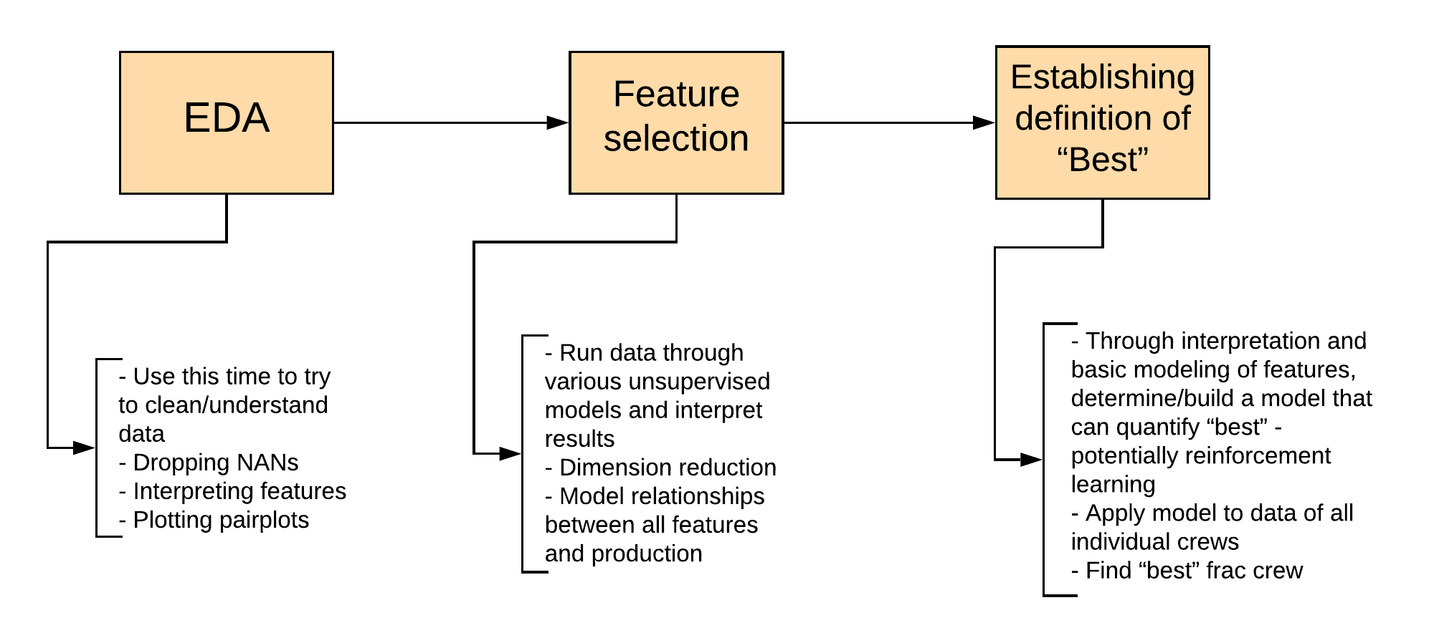
Current Workflow

Slide 6
Conclusion
Potential Weaknesses
Our interpretation of the best frac crew could vary from ConocoPhillips because there is no clear definition as to what “best” means
Initially running our data through an unsupervised model might result in ineffective groupings of variables/features
Summary/Message
With the given data, we will determine the best frac crew by interpreting the features and its relationships to production
This is important because of the rise in unconventional natural gas energy, which can enhance the growth of the company

